Slide 1
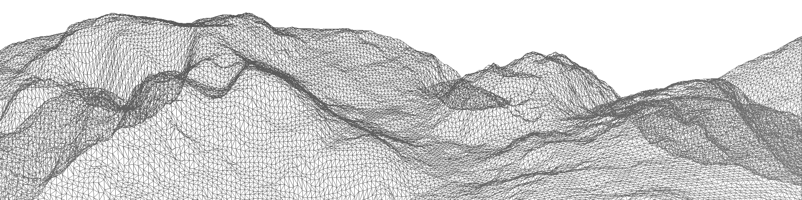
Improving modelled mountain flows with alternative representations of terrain
Hoskins Half Hour
James Shaw
Hilary Weller, John Methven, Terry Davies

Slide 2
Outline
Representing orography
Mountain flows
Ideas and discussion

Slide 3
1. Representing orography

Slide 4
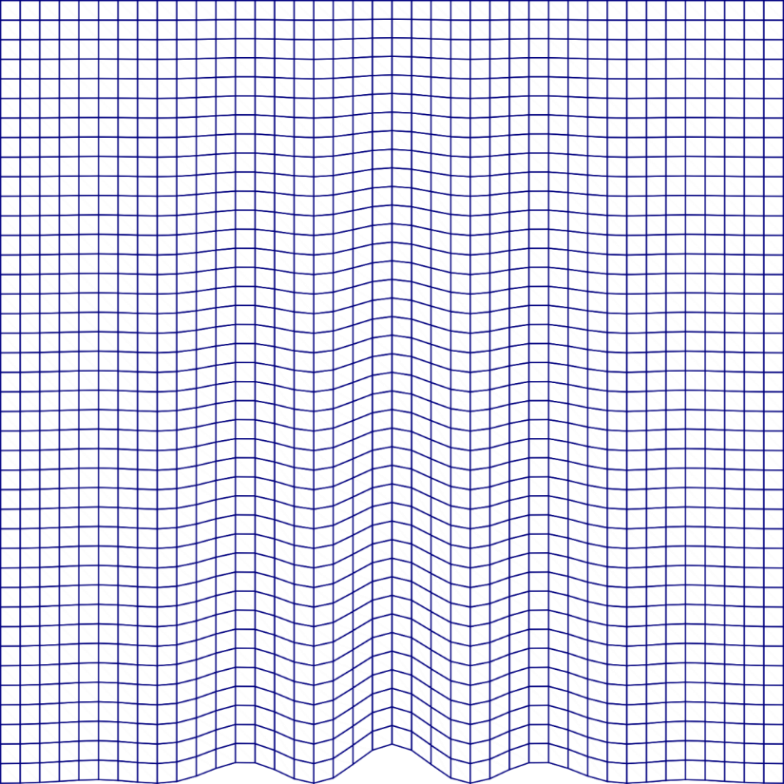
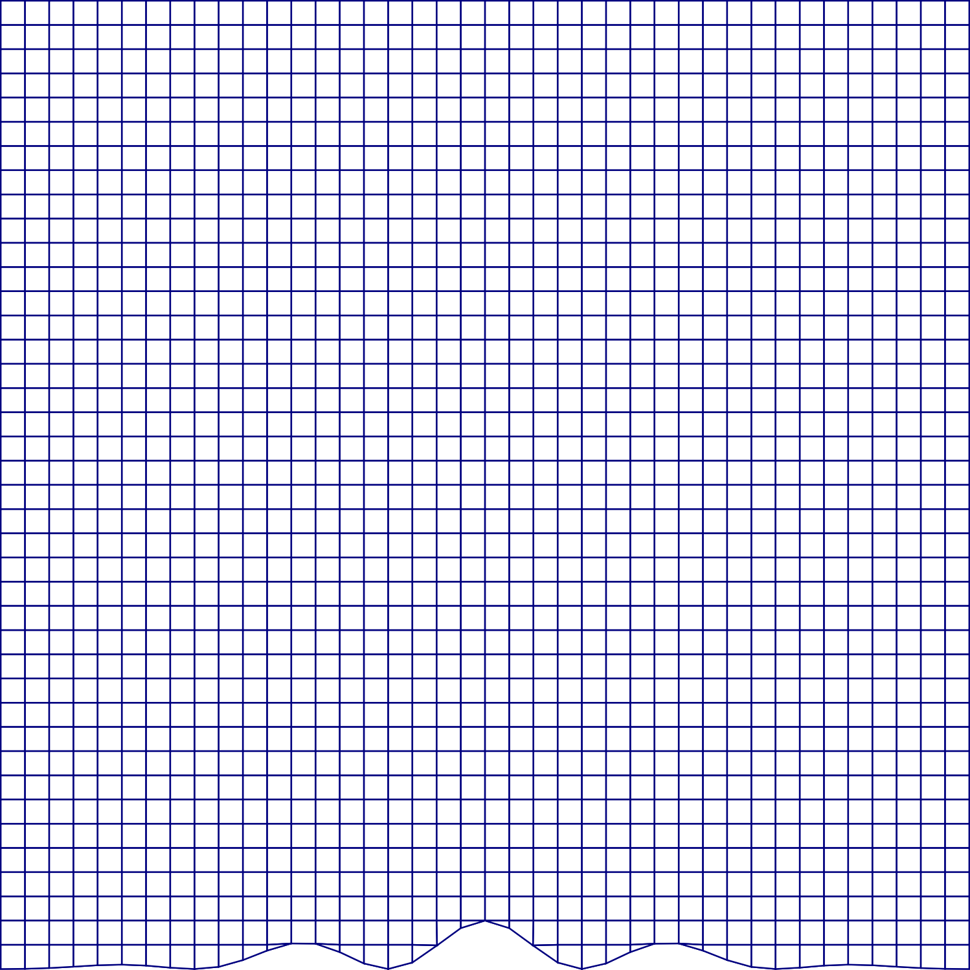
Representing orography
Terrain following layers
Cut cells

Slide 5
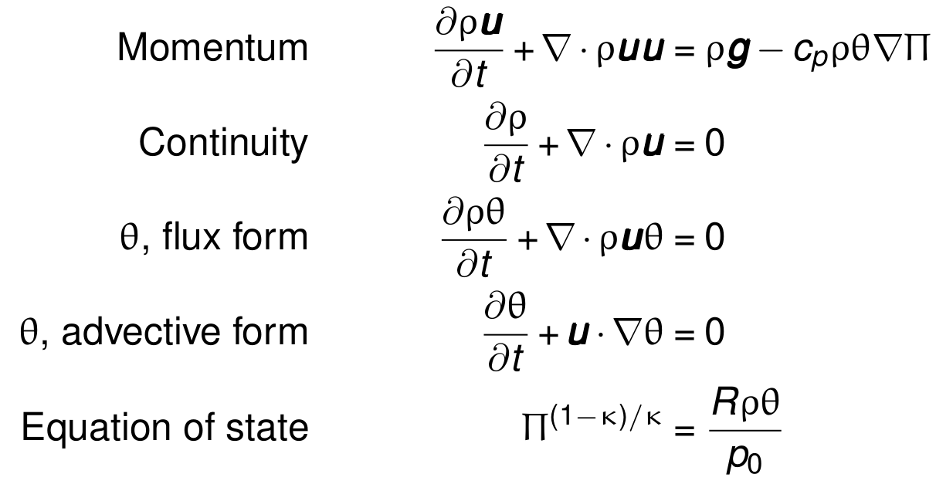
Sources of Numerical Error

Slide 6

Sources of Numerical Error

Slide 7
Horizontal Pressure gradient

Slide 8
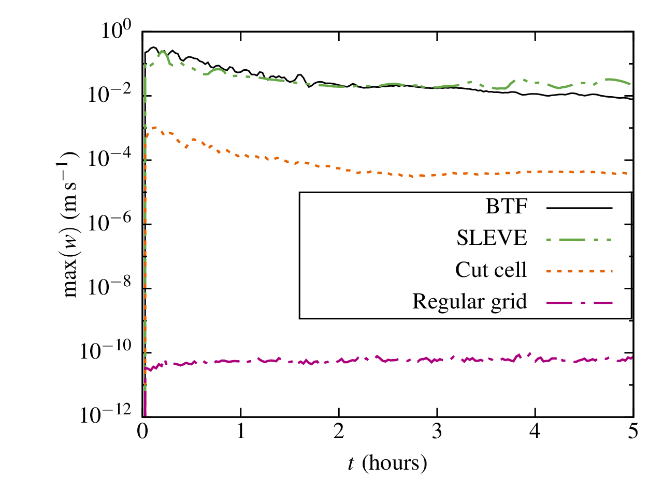
Atmosphere initially at rest
Terrain following

Slide 9
Advection Errors

Slide 10
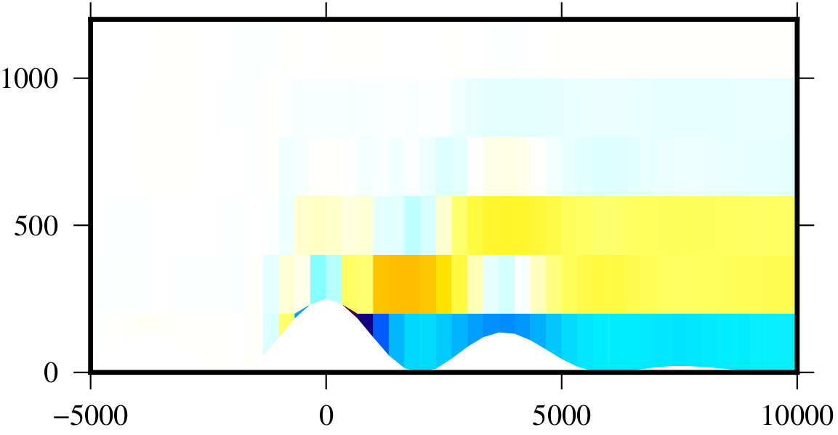
Advection Errors: Cut Cell

Slide 11
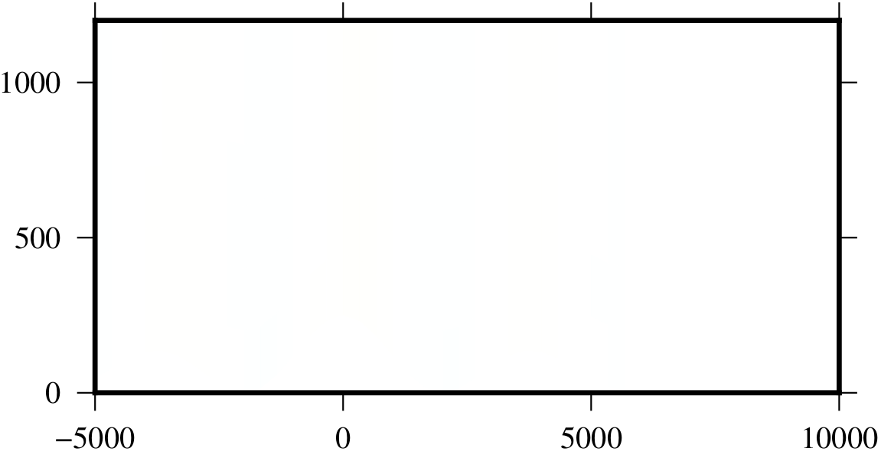
Advection Errors: BTF

Slide 12
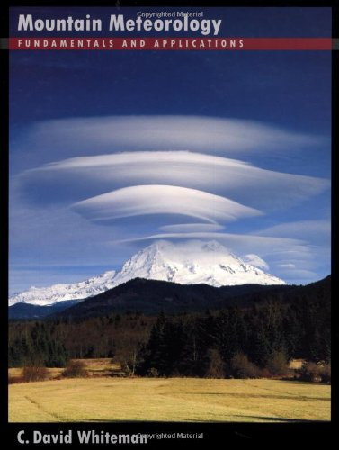
2. Mountain Flows

Slide 13
Mountain Flows
Planetary
Synoptic
Mesoscale
Diurnal (thermally-driven)

Slide 14
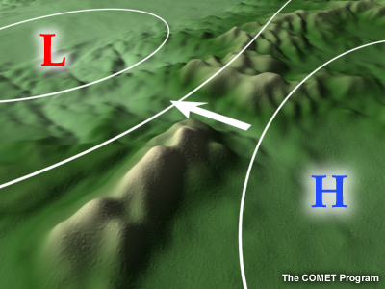
Pressure-Driven Channelling
Source: COMET MetEd

Slide 15
Modelling gap flows
Gohm et al. (2004, MWR) simulated gap flows:
267m resolution
Cross-sectional area
Manual correction of terrain data
Height differences between observations and model terrain

Slide 16
Gap Flows in the Ocean
Adcroft (2013, Ocean Mod.) improves representation of bathymetry:
No manual intervention
“Thin walls” block flow between cells
“Porous barriers” represent sub-grid scale topography

Slide 17
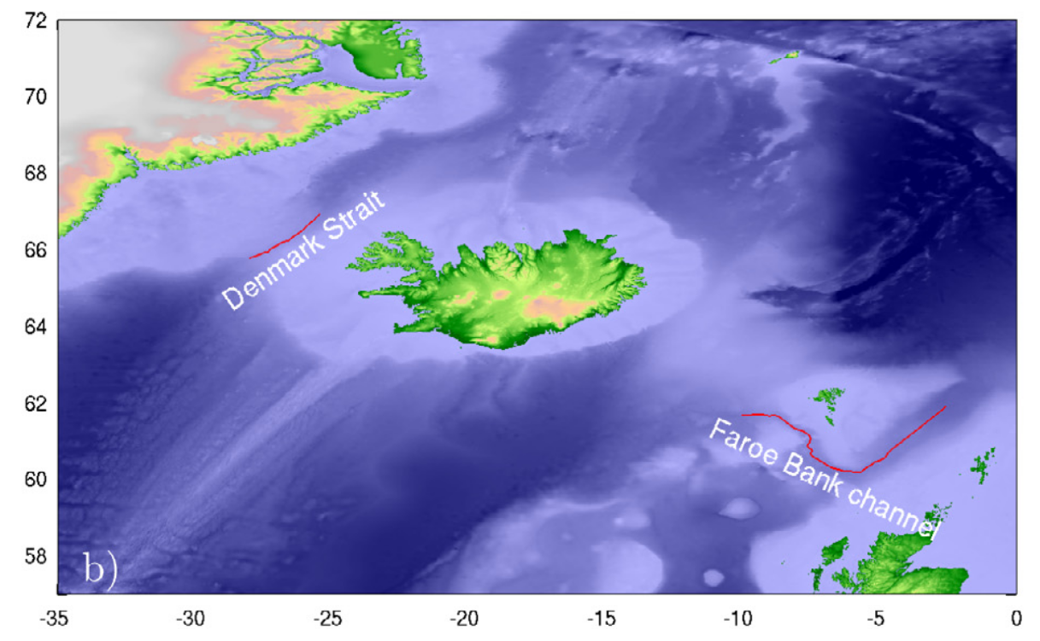
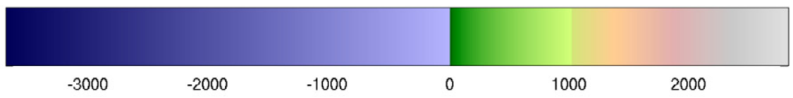
Gap Flows in the Ocean Adcroft (2013, Ocean Mod.)
Greenland
Iceland

Slide 18
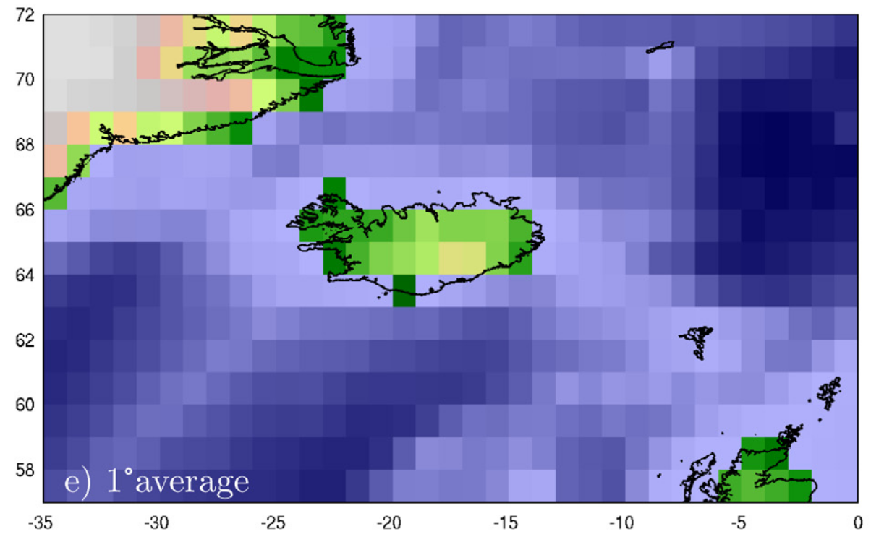
Gap Flows in the Ocean Adcroft (2013, Ocean Mod.)

Slide 19
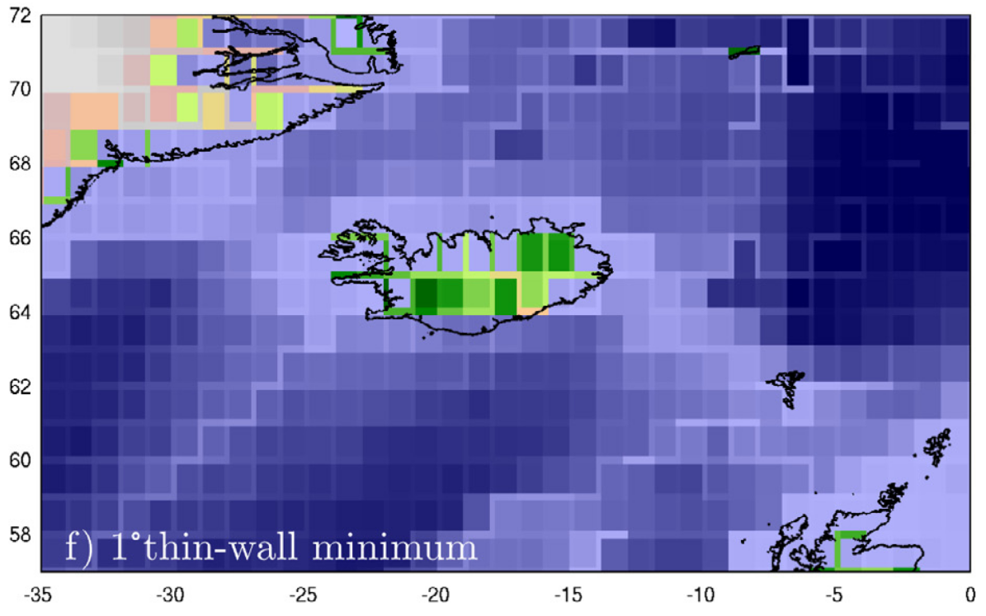
Gap Flows in the Ocean Adcroft (2013, Ocean Mod.)

Slide 20
Mountain Flows: Diurnal
Along-valley flow
Slope flow
Cold air pooling

Slide 21
Cold Air Pooling

Slide 22
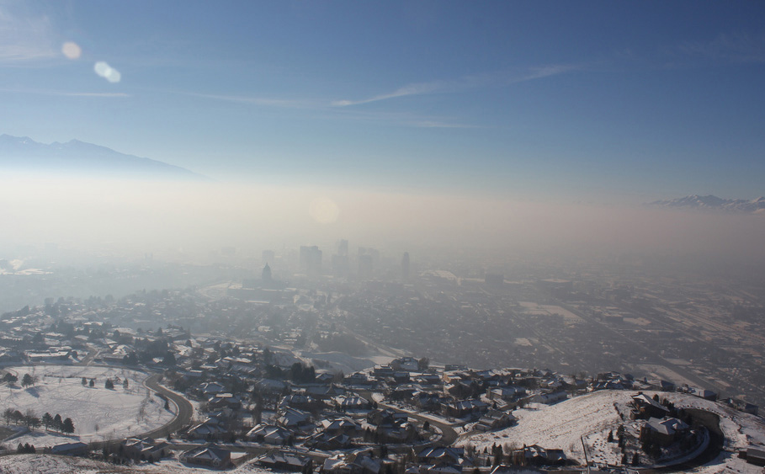
Cold Air Pooling Source: NCAR AtmosNews

Slide 23
Ideas and Discussion
Cut cells for cold air pools
Terrain following layers for slope flows
Thin walls and porous barriers for gap flows
More Ideas?

